Slide 1
Simple Linear Regression and Correlation

Slide 2
LO
Compute various sums of squares for a set of data pairs.
Determine the equation of linear regression and the correlation coefficient; use linear regression to predict future values.
Perform a hypothesis test in simple linear regression; test the significance of regression using t-test and F-test.

Slide 3
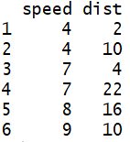
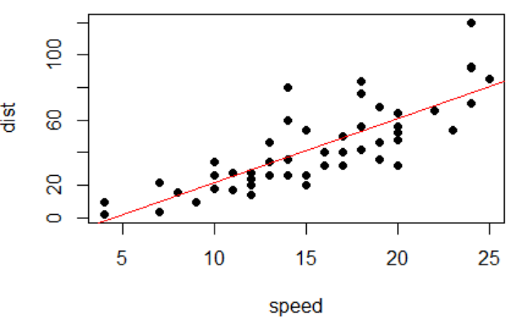

Introduction
dist = -17.58 + 3.93speed
Speed and stopping distance of cars.
.
.
.
.
.
.
.
.
.
Notes:
# In R
plot(dist ~ speed, data = cars, pch = 16)
cars.lm <- lm(dist ~ speed, data = cars)
abline(coef(cars.lm),col=‘red’)

Slide 4
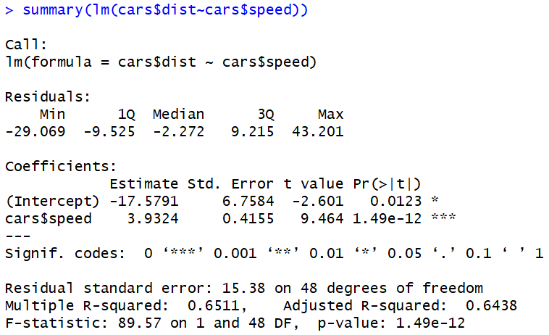
?

Slide 5
Regression (an empirical model)
We have two variables X, Y (numerical data)
We believe that Y depends in some way on X: Y = f(X)
Examples of (X, Y) pairs:
• X = study time and Y = score on a test.
• X = smoking frequency and Y = age of first heart attack.
Given information about X and Y, we would like to predict future values of Y for particular values of X. ➔ Estimate E[Y | X = x].
Dependent variable
Response variable
Independent variable
Predictor
Explanatory variable
Regressor

Slide 6
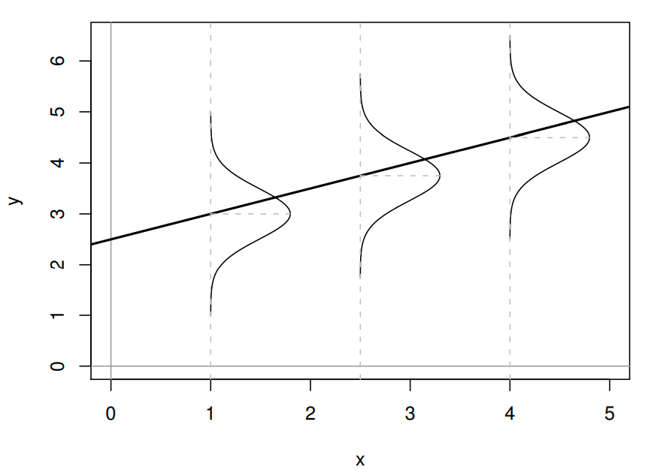
Simple linear regression
Intercept Slope
E[Y | X = x] = β₀ + β₁x,
β₀ and β₁ are unknown regression coefficients ➔ to be estimated.
We assume that each observation, Y, can be described by the model Y = β₀ + β₁x + ε, // ε : random error
ε ∼ N(0, σ²)
We never know exactly β₀, β₁, ε, σ²
➔ Estimation, hypothesis testing on these parameters ➔ prediction

Slide 7
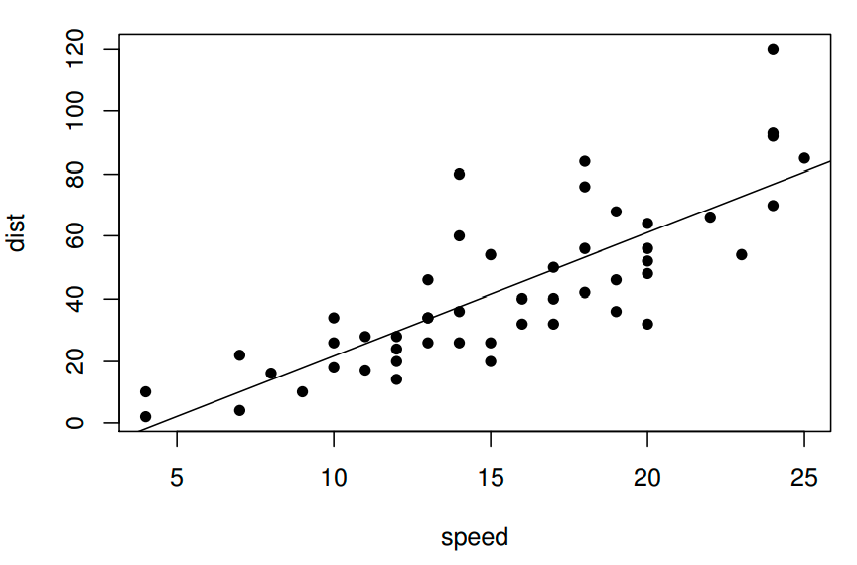
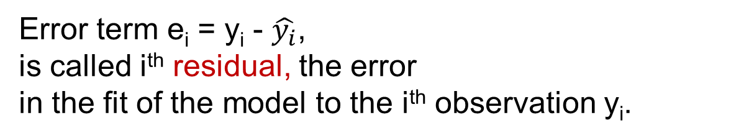
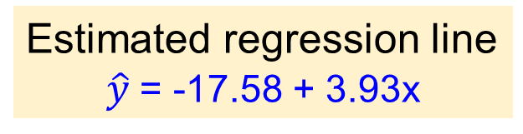
Example - cars
Estimated regression line
$\hat{y}$= -17.58 + 3.93x
Speed and stopping distance of cars.
Data point (x₂₆, y₂₆) =
(speed = 15, dist = 54)
•
|
e₂₆ = y₂₆ – (-17.58 + 3.93x₂₆)
= 12.63
Scatter plot
Error term e_{i} = y_{i} - $\hat{y_{i}}$,
is called i^{th} residual, the error
in the fit of the model to the i^{th} observation y_{i}.
Notes:
MC Question: Residual is ___

Slide 8
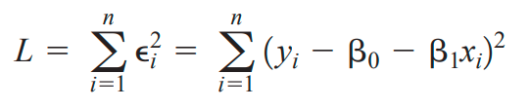
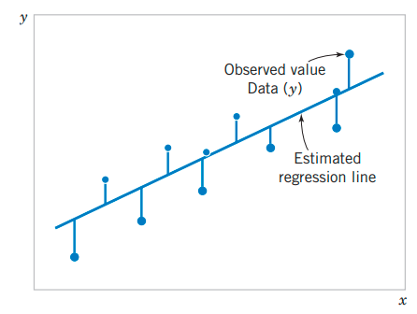
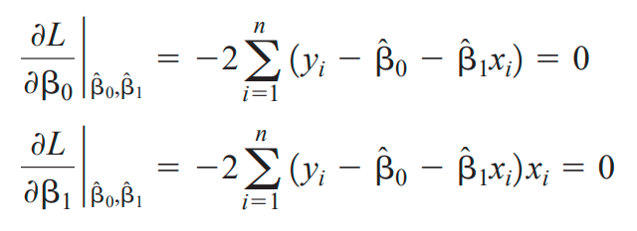

Method of least squares
The method of least squares is used to estimate the parameters, β₀ and β₁ by minimizing L, the sum of the squares of the vertical deviations
{
Error term e_{i} = y_{i} - $\hat{y_{i}}$, or residual

Slide 9
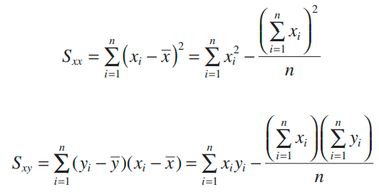
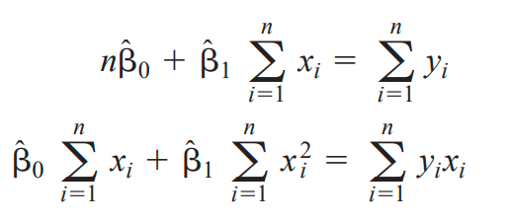
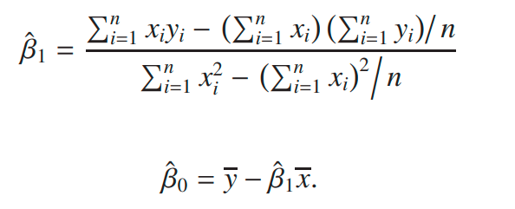
Least squares estimates of β₀, β₁
Least squares normal equations
= S_{xy}/S_{xx}
Notes:
S_xy = (x – mean(x))%*%(y – mean(y))
S_xx = ||x – mean(x)||^2

Slide 10

Cars - Estimates of β₀, β₁
Estimated regression line
y = -17.58 + 3.93x
True regression line
dist = β₀ + β₁speed
Estimated regression line
dist = -17.58 + 3.93speed
Notes:
# In R
cars.lm <- lm(dist ~ speed, data = cars)
coef(cars.lm)

Slide 11
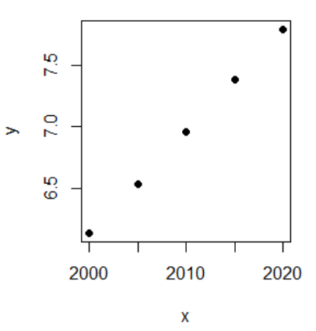
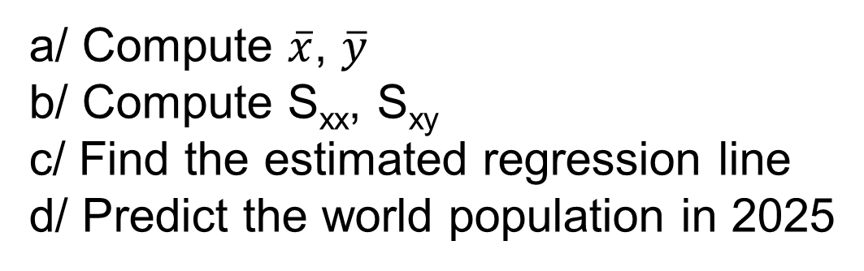
Exercise - World Population
Year World Population (B)
2000 6.14
2005 6.54
2010 6.96
2015 7.38
2020 7.79
a/ Compute $\overline{x}$, $\overline{y}$
b/ Compute S_{xx}, S_{xy}
c/ Find the estimated regression line
d/ Predict the world population in 2025
Population of the world, 2000 – 2020 (Source: worldometers.info)

Slide 12
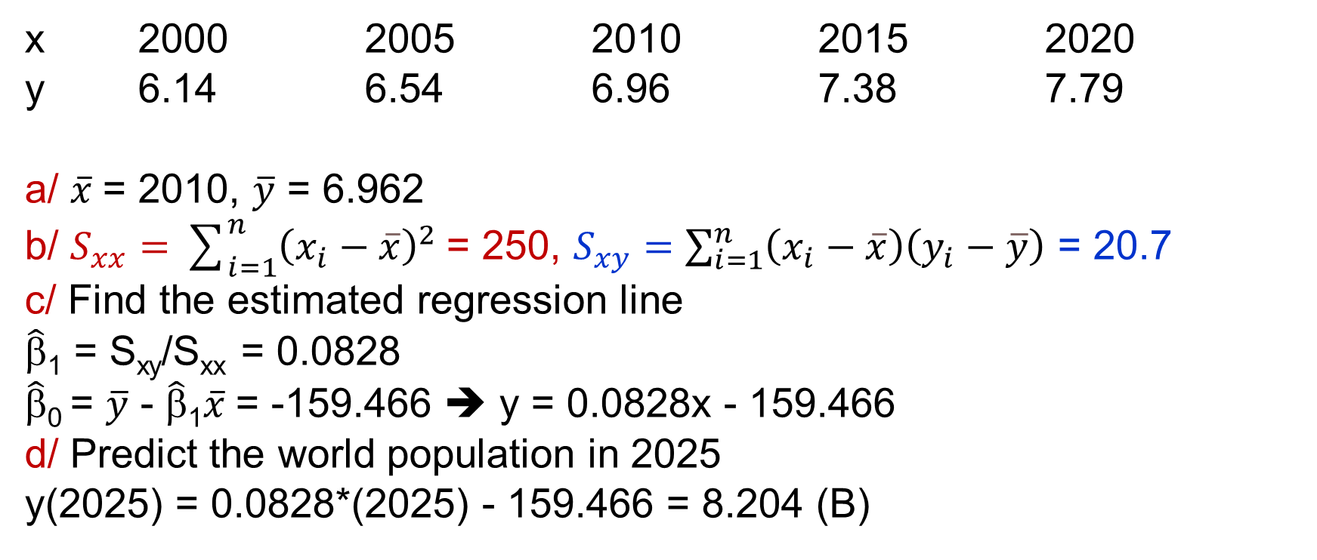
Exercise - World Population
x 2000 2005 2010 2015 2020
y 6.14 6.54 6.96 7.38 7.79
a/ $\overline{x}$= 2010, $\overline{y}$ = 6.962
b/ $S_{xx}=\sum_{i=1}^{n}{{\left(x_{i}−\overline{x}\right)}^{2}}$= 250, $S_{xy}=\sum_{i=1}^{n}{\left(x_{i}−\overline{x}\right)\left(y_{i}−\overline{y}\right)}$ = 20.7
c/ Find the estimated regression line
$\hat{\text{β}}$₁ = S_{xy}/S_{xx} = 0.0828
$\hat{\text{β}}$₀ = $\overline{y}$ - $\hat{\text{β}}$₁$\overline{x}$= -159.466 ➔ y = 0.0828x - 159.466
d/ Predict the world population in 2025
y(2025) = 0.0828*(2025) - 159.466 = 8.204 (B)
Notes:
x<-c(2000,2005,2010,2015,2020)
y<-c(6.14, 6.54, 6.96, 7.38, 7.79)
sxy<-(x-mean(x))%*%(y-mean(y))
sxx<-(x-mean(x))%*%(x-mean(x))
betahat1<-sxy/sxx
betahat0<-mean(y)-betahat1*mean(x)
betahat1
betahat0

Slide 13
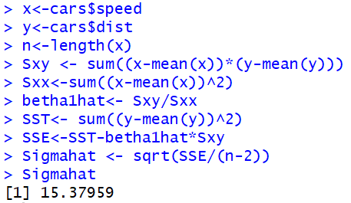

Estimating σ² Error sum of squares SS_{E}
Error Sum of Squares SS_{E}
E(SS_{E}) = (n - 2)σ²
Estimate σ² using SS_{E}
$${\hat{σ}}^{2}=\frac{SSE}{n−2}$$
Total Sum of Squares
Notes:
# In R
carsum<-summary(cars.lm)
carsum$sigma
x<-cars$speed
y<-cars$dist
n<-length(x)
Sxy <- sum((x-mean(x))*(y-mean(y)))
Sxx<-sum((x-mean(x))^2)
Betha1hat<- Sxy/Sxx
SST<- sum((y-mean(y))^2)
SSE<-SSE – betha1hat*Sxy
Sigmahat <- SSE/(n-2)
Sigmahat

Slide 14


Properties of the Least Squares Estimators
E(${\hat{β}}_{1}$) = β₁, E(${\hat{β}}_{0}$) = β₀
V(${\hat{β}}_{1}$) = $\frac{σ^{2}}{S_{xx}}$
V(${\hat{β}}_{0}$) = σ²$\left[\frac{1}{n}+\frac{{\overline{x}}^{2}}{S_{xx}}\right]$
Estimated Standard Errors:
Notes:
Se1<- sqrt(Sigmahat^2/Sxx)
Se0 <- sqrt(Sigmahat^2*(1/n+mean(x)^2/Sxx))
c(Se1,Se0)

Slide 15
Exercises
x: 1 2 3 4 5
y: 3 4 4 5 6
a/ Compute SS_{E}, SS_{T}
b/ Estimate σ²
c/ Estimate standard error
of the slope and the intercept

Slide 16
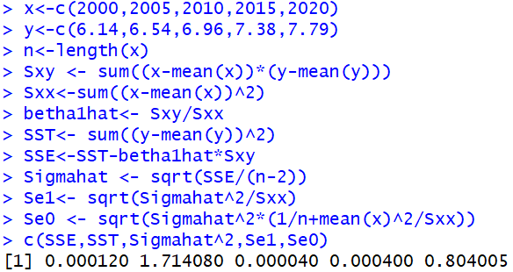
Exercise – World population
x 2000 2005 2010 2015 2020
y 6.14 6.54 6.96 7.38 7.79
a/ Compute SS_{E}, SS_{T}
b/ Estimate σ²
c/ Estimate standard error
of the slope and the intercept

Slide 17
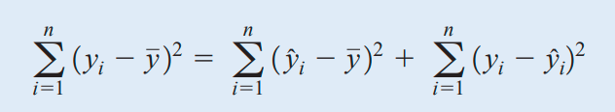

Exercise
Show that

Slide 18
ANOVA
ANOVA Identity
Total variation = Explained variation + Unexplained variation.
SS_{R}: Regression Sum of Squares
➔ (variation explained by linear model)
SS_{E}: Error Sum of Squares
➔ (unexplained variation)

Slide 19
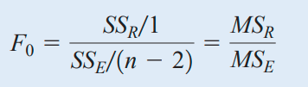
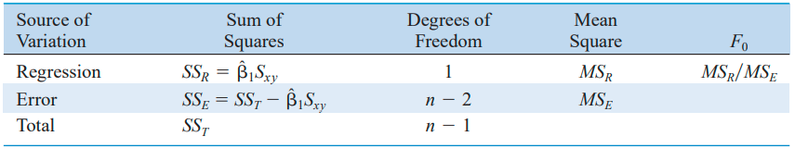
F-test
F-test:
F_{1,n - 2} distribution
Reject H₀: β₁ = 0
if f₀ > f_{α,1,n - 2}
We reject H₀: β₁ = 0 when F is large – that is, when the explained variation is large relative to the unexplained variation.

Slide 20
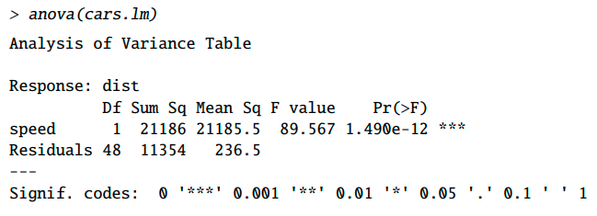
ANOVA
Verify f₀ > f_{α,1,n - 2}
Here we see that the F statistic is 89.57 with a p-value very close to zero.
Conclusion: there is very strong evidence that H₀ : β₁ = 0 is false, that is, there is strong evidence that β₁ ≠ 0. Moreover, we conclude that the regression relationship between dist and speed is significant.

Slide 21
Exercise - World population
x 2000 2005 2010 2015 2020
y 6.14 6.54 6.96 7.38 7.79
Complete the ANOVA table
Source | Sum of squares | Degrees of freedom | Mean squares | F₀
Regression | SS_{R} = ? | 1 | MS_{R} = SS_{R}/1 = ? | MS_{R}/MS_{E} = ?
Error | SS_{E} = ? | n - 2 = ? | MS_{E} = SS_{E}/(n-2) = ?
Total | SS_{T} = ? | n -1 = ?

Slide 22
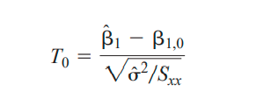
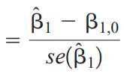
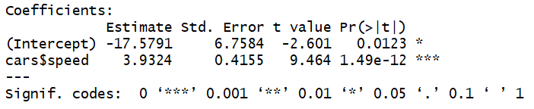
t-test on β₁
Suppose we wish to test:
H₀: β₁ = β_{1,0}
H₁: β₁ ≠ β_{1,0}
Test statistic
the t distribution with n - 2 degrees of freedom
We would reject H₀:
|t₀| > t_{α/2, n-2}
H₀: β₁ = 0
H₁: β₁ ≠ 0

Slide 23
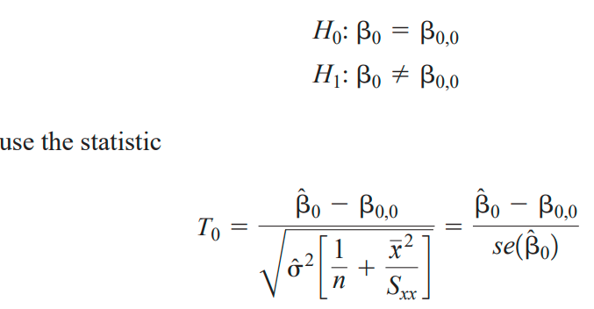
t-test on β₀
We would reject H₀:
|t₀| > t_{α/2, n-2}
H₀: β₀ = 0
H₁: β₀ ≠ 0

Slide 24
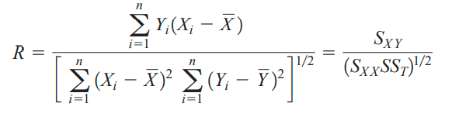
Regression and correlation
Covariance Cov(X,Y) is a measure of linear relationship between the random variables X and Y.
Correlation coefficient
-1  ρ  +1
Sample correlation coefficient R
Notes:
Sigma(Yi - Ybar)(Xi – Xbar) = sigmaYi(Xi – Xbar) – sigmaYbar(Xi – Xbar) = sigmaYi(Xi – Xbar)

Slide 25
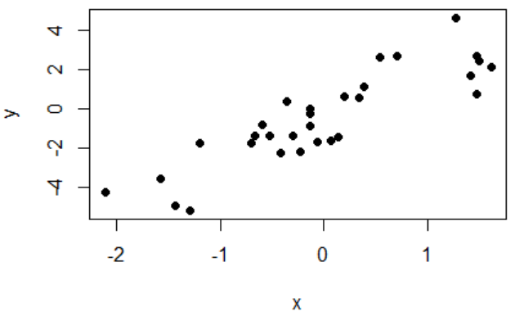
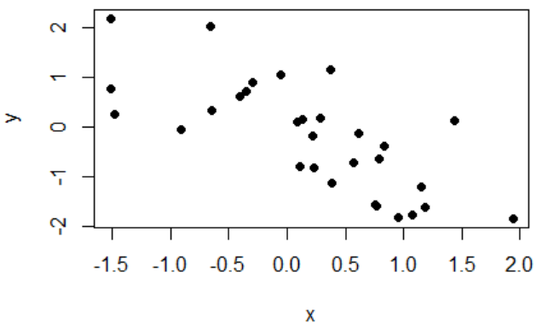
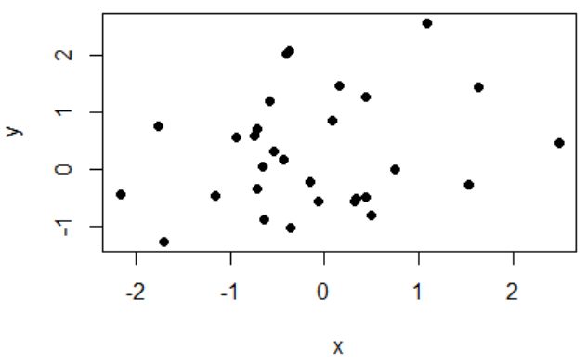
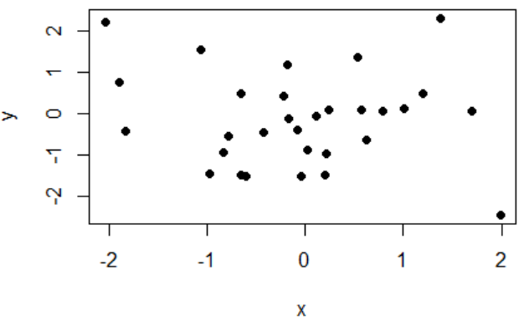
Sample correlation and scatter plot
r = 0.88
r = -0.73
r = 0.23
r = -0.11
Notes:
x<-rnorm(30)
y<--1.2*x+rnorm(30)
plot(x,y,pch=16)
sxy<-sum(y*(x-mean(x)))
sxx<-sum((x-mean(x))^2)
ssT<-sum((y-mean(y))^2)
r<-sxy/((sxx*ssT)^(1/2))
rx<-rnorm(30)
y<--1.2*x+rnorm(30)
plot(x,y,pch=16)
sxy<-sum(y*(x-mean(x)))
sxx<-sum((x-mean(x))^2)
ssT<-sum((y-mean(y))^2)
r<-sxy/((sxx*ssT)^(1/2))
r

Slide 26
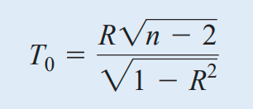
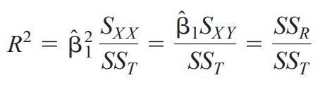
Test Statistic for Zero Correlation
Reject H₀: ρ = 0 if
t₀ > t_{α/2,n - 2}
t distribution with n - 2 degrees of freedom if
H₀: ρ = 0 is true
Note.
R² = 1 – SS_{E}/SS_{T}
0  R²  1: coefficient of determination

Slide 27
Example
(Efficiency of computer programs). A computer manager needs to know how efficiency of her new computer program depends on the size of incoming data. Efficiency will be measured by the number of processed requests per hour. Applying the program to data sets of different sizes, she gets the following results,
x (data size, Gigabytes) 6 7 7 8 10 10 15
y (processed requests) 40 55 50 41 17 26 16
In general, larger data sets require more computer time, and therefore, fewer requests are processed within 1 hour. The response variable here is the number of processed requests (y), and we attempt to predict it from the size of a data set (x).

Slide 28
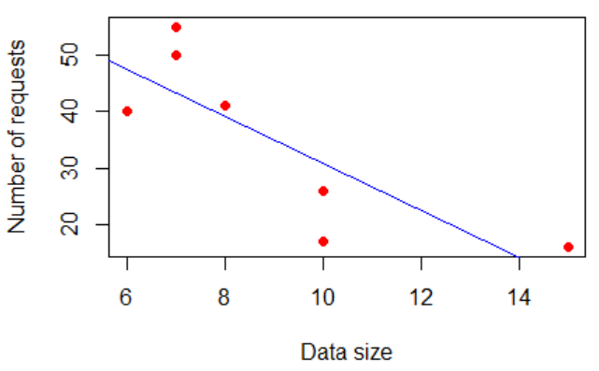

Slide 29
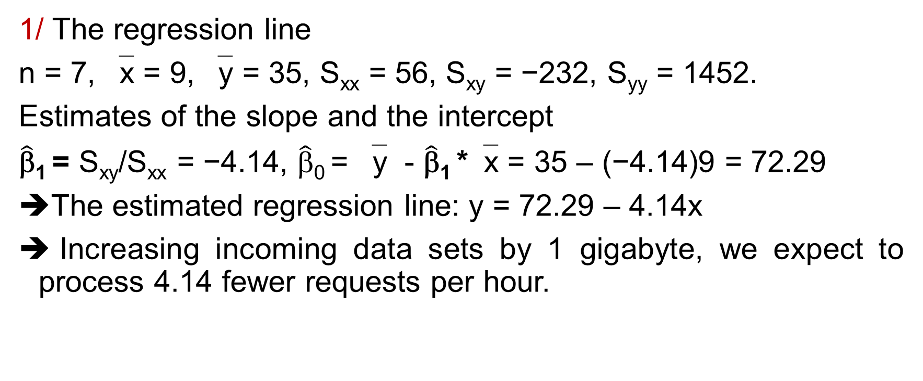
Example (cont.)
1/ The regression line
n = 7, ‾x = 9, ‾y = 35, S_{xx} = 56, S_{xy} = −232, S_{yy} = 1452.
Estimates of the slope and the intercept
$\hat{\text{β}}$₁ = S_{xy}/S_{xx} = −4.14, $\hat{\text{β}}$₀ = ‾y - $\hat{\text{β}}$₁ *‾x = 35 – (−4.14)9 = 72.29
The estimated regression line: y = 72.29 – 4.14x
Increasing incoming data sets by 1 gigabyte, we expect to process 4.14 fewer requests per hour.

Slide 30

Example (cont.)
2/ ANOVA table
We have SS_{T} = S_{yy} = 1452 partitioned into SS_{R} = $\hat{\text{β}}$₁²S_{xx} = 961 and SS_{E} = SS_{T} − SS_{R} = 491.
Source | Sum of squares | Degrees of freedom | Mean squares | F₀
Regression | SS_{R} = 961 | 1 | MS_{R} = SS_{R}/1 = 961 | MS_{R}/MS_{E} = 9.79
Error | SS_{E} = 491 | n - 2 = 5 | MS_{E} = SS_{E}/(n-2) = 98.2
Total | SS_{T} = 1452 | n -1 = 6

Slide 31
Example (cont.)
3/ (t-test on the slope β₁) Does the number of processed requests really depend on the size of data sets?
We wish to test
H₀ : β₁ = 0, H₁ : β₁ ≠ 0
T-statistic:
Use α = 0.05, 3.13 = |t₀| > t_{α/2,n-2} = t_{0.025,5} = 2.571 ➔ Reject H₀ at the 0.05 level of significance

Slide 32
Example (cont.)
4/ ANOVA F-test
A similar result is suggested by the F-test.
f₀ = MS_{R}/MS_{E} = 9.79
9.79 = f₀ > f_{α,1,n - 2} = f_{0.05,1,5} = 6.61 ➔ Reject H₀: β₁ = 0 at the 0.05 level of significance
5/ R² (R-square)
R² = SS_{R}/SS_{T} = 961/1452 = 0.6619
➔ 66.19% of the total variation of the number of processed requests is explained by sizes of data sets only.

Slide 33
Example (cont.)
6/ t-test on correlation
t₀ = -3.13
➔ Reject H₀: ρ = 0 at the 0.05 level
ρ: correlation coefficient

Slide 34
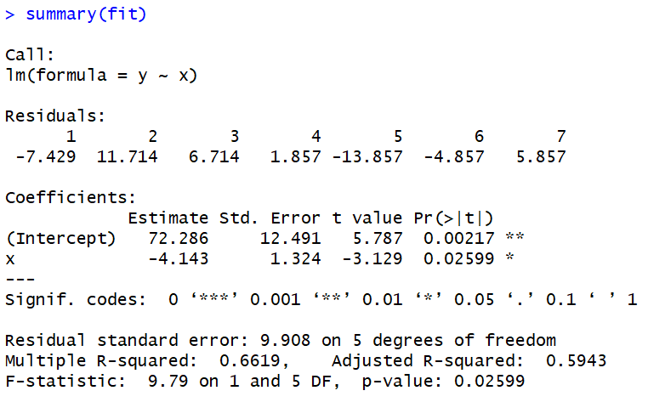
x 6 7 7 8 10 10 15
y 40 55 50 41 17 26 16

Slide 35
THANKS

